Slide 1

32555 – Fundamentals of Software Development

Slide 2
Welcome to 32555 – Fundamentals of Software Development
Your Teaching Team:
Dr. Yining Hu | Subject Coordinator
Yining is a Lecturer in Software Engineering. She works with many SMEs to develop software and AI solutions through student and research projects at UTS.
Contact: yining.hu@uts.edu.au
Dr. Xiaojie (Zoe) Lin | Tutor
Zoe is a full-stack software engineer with an interest in data analysis, specializing in JAVA, R, Python, JavaScript, PHP, Bash, and MATLAB; familiar with AWS.
Contact: Xiaojie.Lin@uts.edu.au
Dr. Farshid Keivanian | Tutor
Dr. Farshid Keivanian is an experienced university lecturer and researcher with a PhD in Information Technology. He has over 15 years of teaching experience across Australian institutions, specialising in software engineering, data science, AI, and cybersecurity.
Contact: Farshid.Keivanian@uts.edu.au
Yong Pov | Tutor
Yong is a full-stack software engineer with experience in React, JavaScript, TypeScript, Java, Python, SQL, and AI-assisted learning platforms.
Contact: Yong.Pov@uts.edu.au

Slide 3
Welcome to 32555 – Fundamentals of Software Development
Cmp1 # | Location | Time | Tutor
01 | CB11.B1.400 | Fri 16:00-18:00 | Xiaojie (Zoe) Lin
07 | CB11.B1.401 | Wed 10:00-12:00 | Farshid Keivanian
08 | CB11.B1.400 | Fri 12:00-14:00 | Yong Pov
09 | CB11.B1.103 | Wed 16:00-18:00 | Farshid Keivanian
10 | CB11.B1.401 | Wed 12:00-14:00 | Farshid Keivanian

Slide 4
Week 9 Outline
Lab 9
Exceptions
  Example 1 – Python Exception (try/except/finally).
  Activity 1 (Python – Division Safety)
  Activity 2 (Python – File Error)
Errors vs Exceptions
  Java Example 2 – Exception Handling (divide by zero, number format)
  Activity 3 (Java – Read File)
  Activity 4 (Java – Custom Exception: InvalidMarkException)
File Handling Basics (Python)
File Handling Basics (Java)
Files & Directories
Unit Testing
Why Exceptions? Where Do We See Testing?
Role-Playing Debate Questions
Quiz 2 Preparation & Guideline
MQs designed in Week 9 (Files, Exceptions, Testing)

Slide 5
Files and Exceptions
Lab 9

Slide 6
Contents
Lab 9 exercises lab time: 120 minutes
Lab 9 has two objectives:
Primary: Implement the DeskBankApp [refer to Lab 7 and 8]
Secondary: Complete the practice exercises [1 to 3]
Complete the Lab 9 exercises using either Java or Python.
Recommended IDE for Java and Python: vscode

Slide 7
Lab 9
Case Study - continued: Revise the Bank class to include file handling capabilities
The Bank class has the following properties:
Revise the CRUD operations in Bank, so that it has:
  a procedure to back up the customers list to a file “customers.data” (generic extension typically for
binary data)
  a procedure to retrieve all customer data from “customers.data”
  a procedure to add a new Customer to the Customers List, and to “customers.data”
  a procedure to remove a customer from the Customers List, and from “customers.data”
  a procedure to retrieve one customer’s bank statement from “customers.data” by entering the
customer’s name
Handle exceptions such as FileNotFoundError, IOError in Python and FileNotFoundException and IOException in Java

Slide 8
Lab 9
Case Study - continued: Writing objects to files
Python: import pickle
Java: implement the java.io.Serializable interface

Slide 9
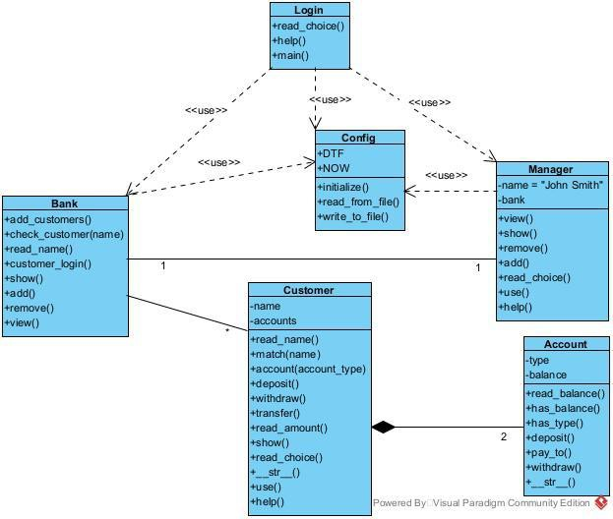
Lab 9
Case Study - continued: Sample Class Diagram
The Login class is the entry point of the program
The Config class provides datetime constants and file handling methods
Bank has the main system menu and interacts with “customers.data”
Manager has the Manager sub-system.
Customer enables customers to perform banking operations, such as deposit, withdraw, transfer, etc.
A Customer has 2 Accounts, which is a composition relationship.
Reference: https://blog.visual-paradigm.com/what-are-the-six-types-of-relationships-in-uml-class-diagrams/

Slide 10
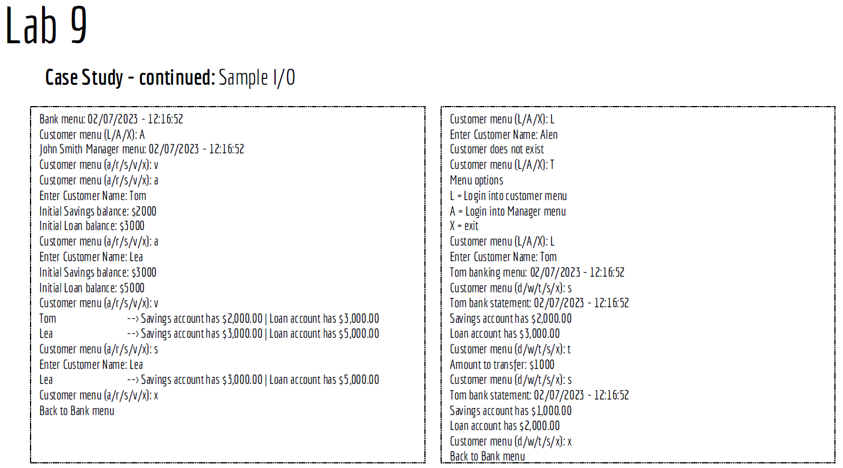

Slide 11
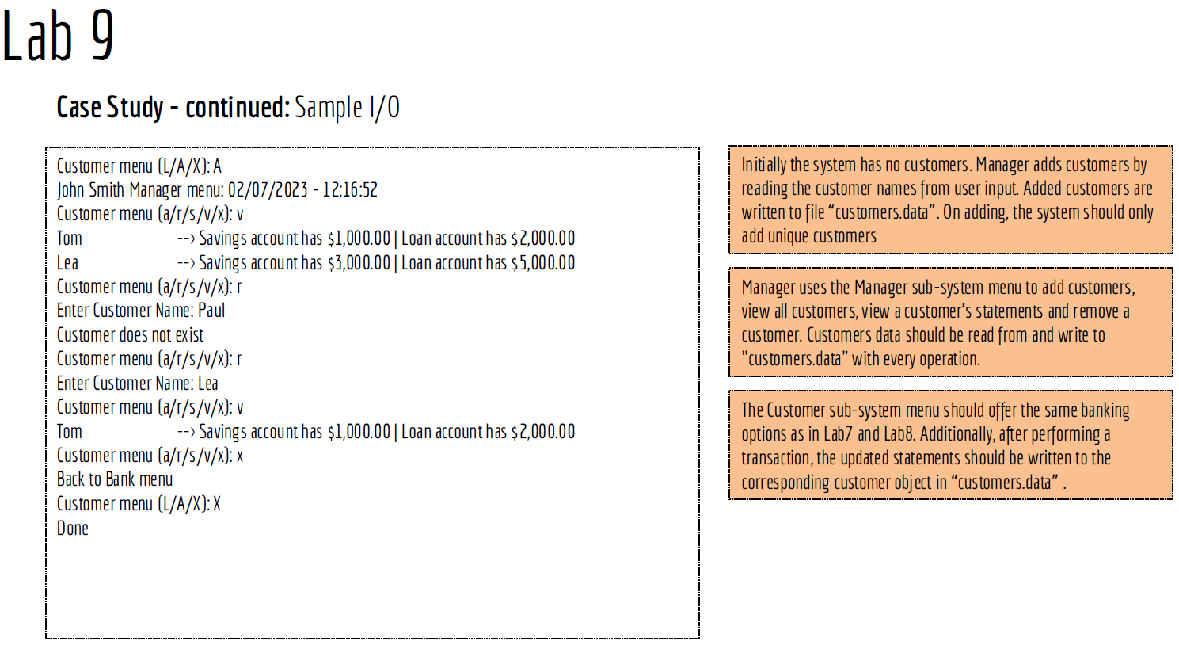

Slide 12
Lab 9 – Lab9Exercise1
Develop the program Lab9Exercise1 in Python that:
Repeatedly reads a string from the user input until the user enters *
Determines the occurrences of each vowel in each user-input string and stores the result into three files
  data.txt, in the following format: <vowel> --> <frequency>
  data.json, with an indentation of 4 spaces
  data.csv
Once the loop is terminated, retrieves and displays the content on all three files

Slide 13
Lab 9 – Lab9Exercise2
Develop the program Lab9Exercise2 (the Game Program) in Java following the below 2 steps:
Step 1: Develop the Player class
Player has two fields:
number - initialized from parameter from the Game class. The player number should start from 1 and increments automatically as new players are created.
score - with a randomly generated integer score between 0 and 10 inclusive.
Override the toString() method to display the player object information as: Player_<number> score: <score>

Slide 14
Lab 9 – Lab9Exercise2
Step 2: The Game class
Game has a list of players with a default constructor
Game has a method play() that initializes the players list with 10 players
Game has a save() method that saves the players to a file “game.data”, if the players from the previous game
were saved, new players will be appended to the file
Game has a show() method that displays the content of game.data
Game has a clear() method that clears all content of game.data
Game has a menu() method that offers the following choices (p/s/v/c/x)
( p ) play
( s ) save ( v ) show ( c ) clear ( x ) exit
Game has a help() method to show the choices and the read function to read the choices
Game has the main() method that invokes the system menu()

Slide 15
Lab 9 – Lab9Exercise3
Develop the program Lab9Exercise3 (The Student Program) in Python following the below 2 steps:
Step 1: The Student class
Student has 3 fields: name, mark, and grade
Student defines a function to determine and return the grade based on the student’s mark (following the
grading schema of UTS).
Student overrides the str () function to show Student object information in the following format:
“<name> ➔ <grade>”

Slide 16
Lab 9 – Lab9Exercise3
Step 2: The Faculty class
Faculty has a students field, and a constructor that creates an empty dictionary of students
Faculty has a method enroll_students() that populates the students dictionary with 10 records where in
each record:
name is formatted as: Student_<ID> [ID is an incremental 3-digit value from 100 to 109] mark is a randomly generated integer between 1 and 100
grade is calculated from the mark: [Z , P, C, D, HD – refer to the UTS grading schema]
Faculty has a save() method to save the students data to a file “grades.csv” [open the file in overwrite mode]
Faculty has a show() method that displays the content of grades.csv
Faculty has a menu() method that offers the following choices (p/s/v/x)
( e ) enrol – adds 10 students with IDs ranging from 100 to 109 with randomly generated marks ( s ) save – save the student records to the grades.csv file
( v ) show – read and show csv content
( x ) exit
Faculty has a help() method to show the choices and the read function to read the choices

Slide 17
Exceptions
What are exceptions?
Special objects that appear when something goes wrong in a program.
Analogy:
Think of it like a fire alarm in a building.
  Normal life (program flow) stops.
  Emergency plan (error handling) starts.

Slide 18
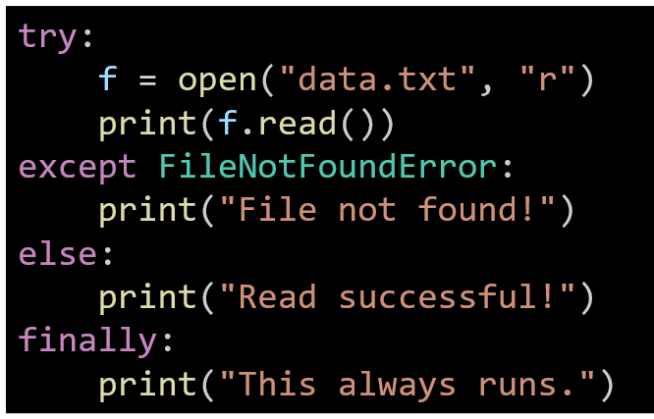
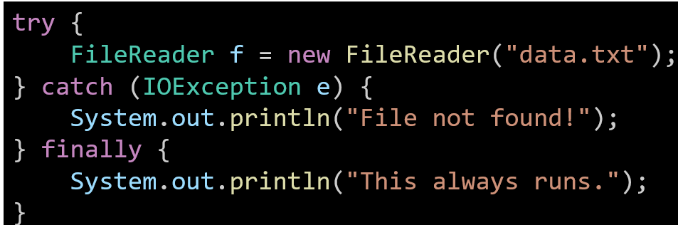
Exceptions
How we handle them:
Python → try – except – else – finally
  try → code that might fail
  except → handles the error
  else → runs if no error happens
  finally → always runs (clean-up, close file, etc.)
Java → try – catch – finally
  try → code that might fail
  catch → what to do if it fails
  finally → always runs
  (clean-up, close file, etc.)

Slide 19
Exceptions
Concepts with Examples
Concept | Java | Python
Raise error | throw, throws | raise
Catch error | catch(Exception e) | except Exception as e:
Finally | Runs every time | Runs every time
Raise error
Java
Python
Meaning: We create/force an error to happen.
Analogy: Like pulling a fire alarm → you announce there’s a problem.
throw new Exception("Something went wrong");
raise Exception("Something went wrong")

Slide 20
Exceptions
Concept | Java | Python
Raise error | throw, throws | raise
Catch error | catch(Exception e) | except Exception as e:
Finally | Runs every time | Runs every time
Concepts with Examples
Catch error
Java
Python
try {
int x = 5 / 0;
} catch (Exception e) {
System.out.println("Error: " + e.getMessage());
}
Meaning: We stop the program from crashing by handling the error.
Analogy: Like firefighters coming to fix the fire alarm situation.
try:
x = 5 / 0
except Exception as e:
print("Error:", e)

Slide 21
Exceptions
Concept | Java | Python
Raise error | throw, throws | raise
Catch error | catch(Exception e) | except Exception as e:
Finally | Runs every time | Runs every time
Concepts with Examples
Finally (Always runs)
Java
Python
try {
System.out.println("Try block");
} finally {
System.out.println("This always runs");
}
Meaning: This part always runs, whether there was an error or not.
Analogy: Like filling the incident report after a fire drill → it happens no matter what.
try:
print("Try block")
finally:
print("This always runs")

Slide 22
Example 1 – Python Exception
try:
a = int(input("Enter number: "))
print(10/a)
except ZeroDivisionError:
print("Cannot divide by zero")
except ValueError:
print("Please enter a valid integer")
finally:
print("Done")
try: → test some code that might fail.
a = int(input(...)) → ask user for a number.
10/a → divide 10 by that number.

Slide 23
Example 1 – Python Exception
try:
a = int(input("Enter number: "))
print(10/a)
except ZeroDivisionError:
print("Cannot divide by zero")
except ValueError:
print("Please enter a valid integer")
finally:
print("Done")
except ZeroDivisionError: → if user types 0, show a clear error.
except ValueError: → if user types a word, show a clear error.
finally: → always runs at the end (like “cleanup”), prints “Done”.

Slide 24
Example 1 – Python Exception
try:
a = int(input("Enter number: "))
print(10/a)
except ZeroDivisionError:
print("Cannot divide by zero")
except ValueError:
print("Please enter a valid integer")
finally:
print("Done")
Analogy: Like Woolworths checkout → if card declines (error), cashier gives a polite message, not crash.

Slide 25
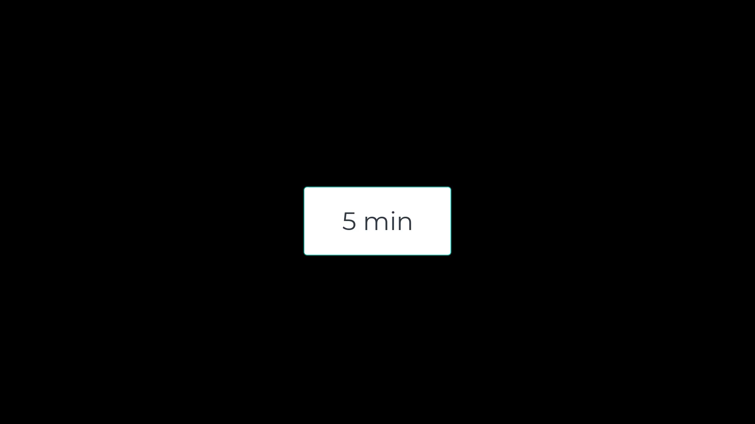
Activity 1 – (Python – Division Safety)
Task: Write code that divides 10 by user input, handle division by zero with try-except.

Slide 26
Activity 1 – (Python – Division Safety)
try:
num = int(input("Enter a number: "))
print(10 / num)
except ZeroDivisionError:
print("Oops, cannot divide by zero")

Slide 27
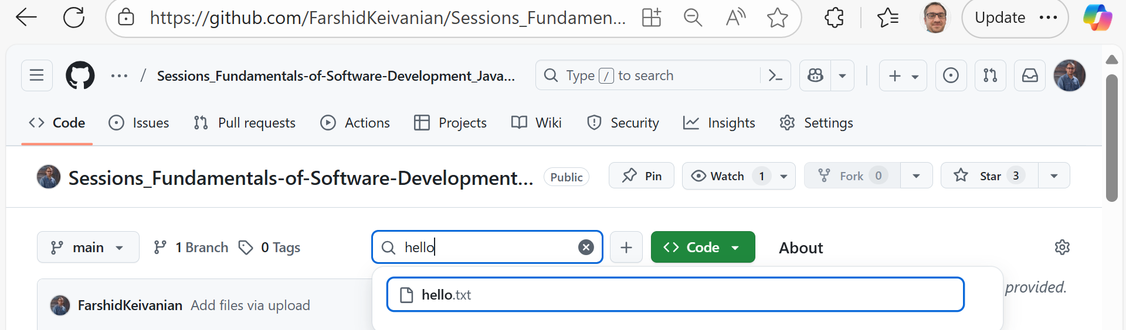
Activity 2 – (Python – File Error)
Task: Modify Example 1 to also try reading hello.txt. If file missing → show “File not found”. (Download ‘hello.txt’ from GitHub)

Slide 28
try:
f = open("hello.txt", "r")
print(f.read())
f.close()
except FileNotFoundError:
print("File not found")
Save hello.txt in the same folder as your .py file. Otherwise, Python can’t find it — just like putting your Woolworths shopping list in the wrong drawer!
If hello.txt is in the same folder as your .py script or notebook → code works.
If it’s in another folder → you must give the full path, e.g.:
Or on Mac/Linux:
f = open("C:/Users/Student/Documents/hello.txt", "r")
f = open("/home/student/hello.txt", "r")

Slide 29
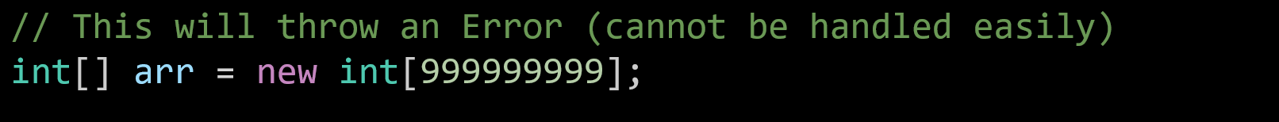
Errors vs Exceptions
What’s the difference?
Errors
  What they are: Serious problems in the system.
  Can we fix them? No, the program usually crashes, and we can’t recover.
  Example: OutOfMemoryError (computer runs out of memory).
  Analogy: Like a train system shutting down because of a massive storm → trains cannot run at all.
  Java Example:

Slide 30
Errors vs Exceptions
Errors are like hardware or system failures.
They are not meant to be caught in your code.
Focus on Exceptions (smaller problems you can handle), not Errors.

Slide 31
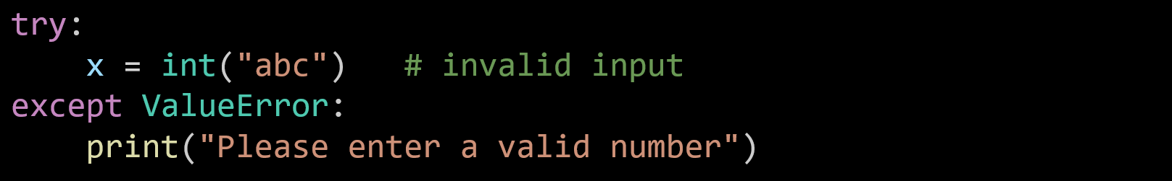
Errors vs Exceptions
Exceptions
What they are: Smaller problems in the program.
Can we fix them? Yes, if the programmer handles them.
Example: Wrong input ("abc" instead of a number) or dividing by zero.
Analogy: Like an Opal card machine – if you tap with an invalid card, the machine rejects it and shows a message, but trains keep running.
  Python example:

Slide 32
Errors vs Exceptions
Exceptions are like mistakes you can catch and fix while the program is running.
If you don’t handle them → program will crash.
If you do handle them → program continues smoothly.

Slide 33
Errors vs Exceptions
Errors = system failure.
Exceptions = programmer can catch and fix.

Slide 34
Example 2 – Java Exception
public class Main {
public static void main(String[] args) {
try {
int a = Integer.parseInt("0");
System.out.println(10 / a);
} catch (ArithmeticException e) {
System.out.println("Cannot divide by zero");
} catch (NumberFormatException e) {
System.out.println("Invalid number");
} finally {
System.out.println("Done");
}
}
}
try { ... } → test risky code.
Integer.parseInt("0") → turn text "0" into number 0.

Slide 35
Example 2 – Java Exception
public class Main {
public static void main(String[] args) {
try {
int a = Integer.parseInt("0");
System.out.println(10 / a);
} catch (ArithmeticException e) {
System.out.println("Cannot divide by zero");
} catch (NumberFormatException e) {
System.out.println("Invalid number");
} finally {
System.out.println("Done");
}
}
}
10 / a → dividing by zero → error.
catch (ArithmeticException e) → catches divide-by-zero.

Slide 36
Example 2 – Java Exception
public class Main {
public static void main(String[] args) {
try {
int a = Integer.parseInt("0");
System.out.println(10 / a);
} catch (ArithmeticException e) {
System.out.println("Cannot divide by zero");
} catch (NumberFormatException e) {
System.out.println("Invalid number");
} finally {
System.out.println("Done");
}
}
}
catch (NumberFormatException e) → catches text like "abc".
finally → always runs → prints “Done”.

Slide 37
Example 2 – Java Exception
public class Main {
public static void main(String[] args) {
try {
int a = Integer.parseInt("0");
System.out.println(10 / a);
} catch (ArithmeticException e) {
System.out.println("Cannot divide by zero");
} catch (NumberFormatException e) {
System.out.println("Invalid number");
} finally {
System.out.println("Done");
}
}
}
Analogy: Like Sydney Trains → if one line fails (error), system re-routes (catch) but still closes gates at night (finally).

Slide 38
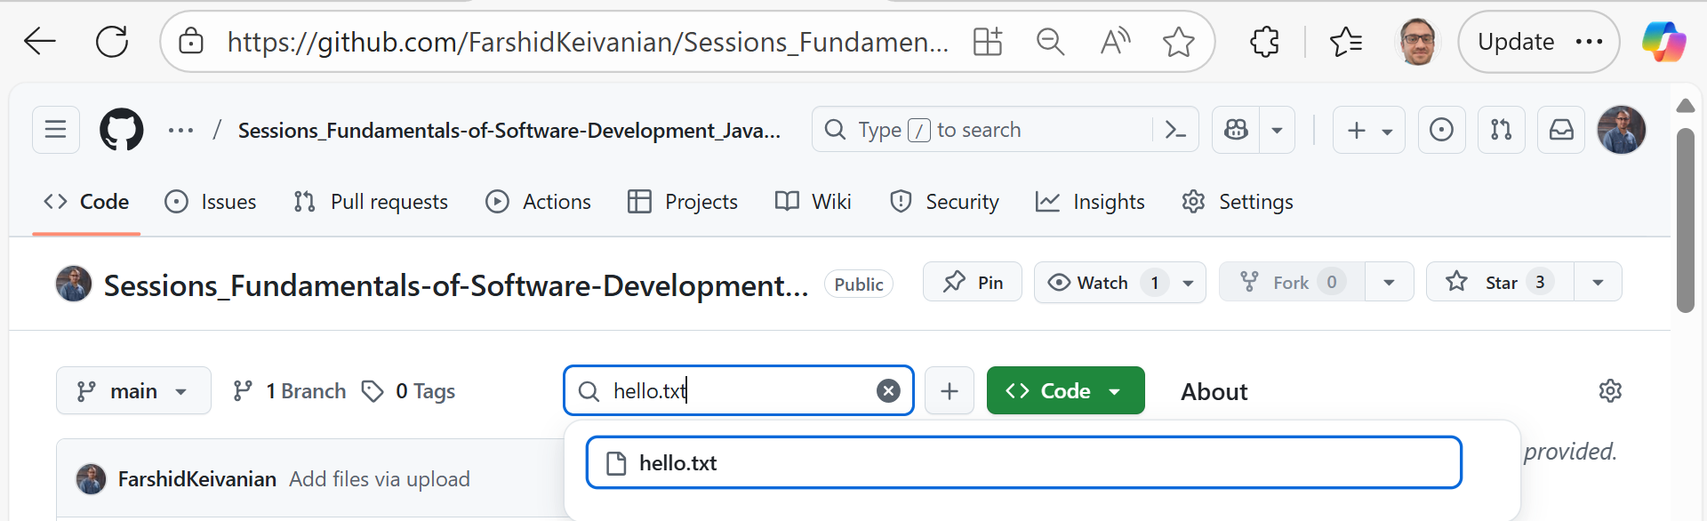
Activity 3 (Java – Read File)
Task: Read a file hello.txt with FileReader, print its content. Download the file from GitHub

Slide 39
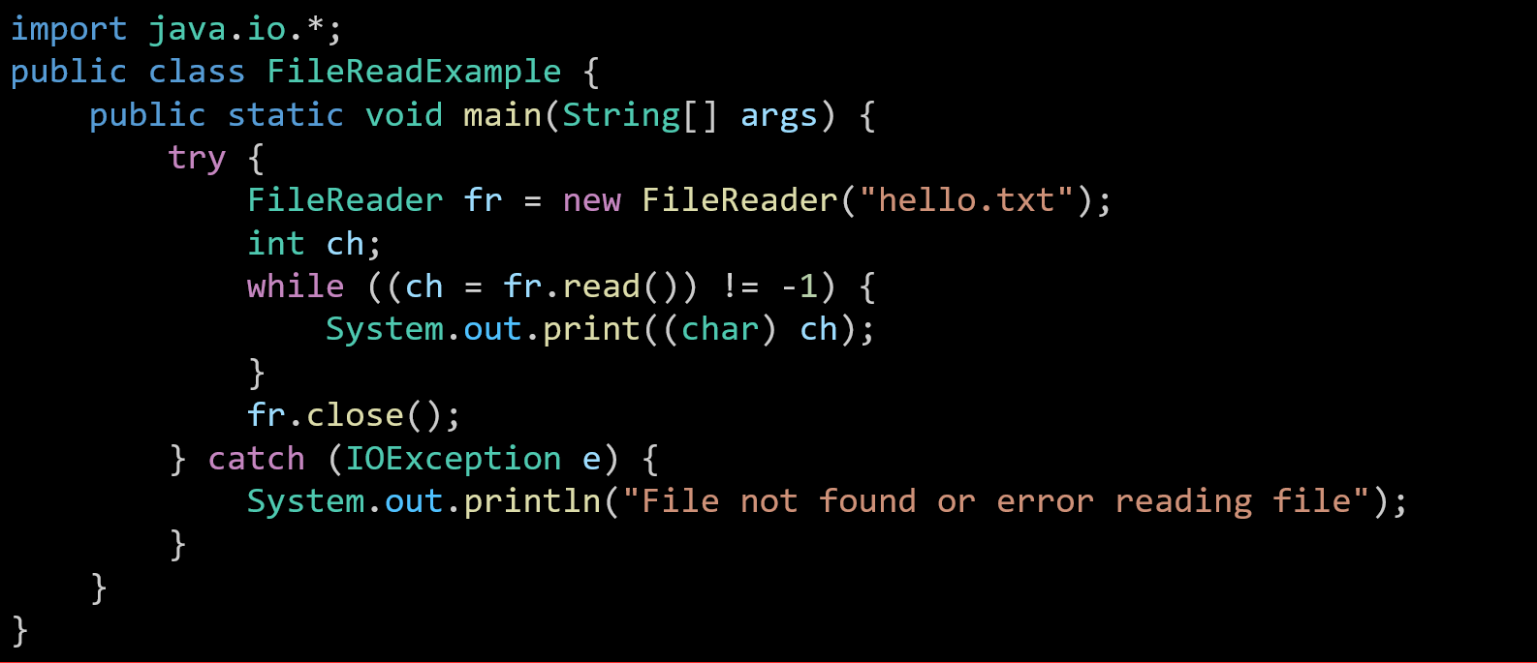
This line tells Java we want to use input/output (I/O) classes, like FileReader for reading files.

Slide 40
Defines a class (container for the code) named FileReadExample. Every Java program needs at least one class.

Slide 41
The main method. This is where the program starts running.

Slide 42
try means “try to do this, but if something goes wrong, handle it later.”
FileReader fr = new FileReader("hello.txt");
This line opens a file called hello.txt for reading.

Slide 43
int ch; → a variable to store one character at a time (Java reads as numbers first).
fr.read() → reads one character from the file.
!= -1 → means “keep going until the end of the file” (-1 = no more characters).
(char) ch → converts the number into the actual character (e.g., 72 → 'H’).
System.out.print(...) → prints each character on the screen.

Slide 44
Closes the file after finishing. (Always a good habit, like returning a library book after reading.)

Slide 45
If something goes wrong (like file missing or unreadable), the program catches the error and shows a friendly message instead of crashing.

Slide 46
In short, this program opens a file called hello.txt, reads it one character at a time, prints everything on the screen, and closes the file. If the file isn’t there, it prints an error message.

Slide 47
Activity 4 (Python and Java – Custom Exception)
Task: Create custom exception InvalidMarkException for student marks <0 or >100.

Slide 48
Python Solution
try:
mark = 120
if mark < 0 or mark > 100:
raise ValueError("Mark out of range!")
print("Valid mark:", mark)
except ValueError as e:
print(e)
try:
  “Try to run this code. If something goes wrong, we’ll handle it.”
mark = 120
  The student’s mark (here, 120 as an example).

Slide 49
try:
mark = 120
if mark < 0 or mark > 100:
raise ValueError("Mark out of range!")
print("Valid mark:", mark)
except ValueError as e:
print(e)
Condition: If the mark is less than 0 or greater than 100…
raise InvalidMarkException("Mark out of range!")
  “Raise” (throw) the custom exception with a message.
Otherwise, it will display Valid mark and shows the content of mark.
In Java this would be throw new InvalidMarkException("...").

Slide 50
try:
mark = 120
if mark < 0 or mark > 100:
raise ValueError("Mark out of range!")
print("Valid mark:", mark)
except ValueError as e:
print(e)
except ... as e:
  This catches the custom error if it happens.
  e holds the error object.
print(e)
  Prints the error message we passed (e.g., "Mark out of range!").

Slide 51
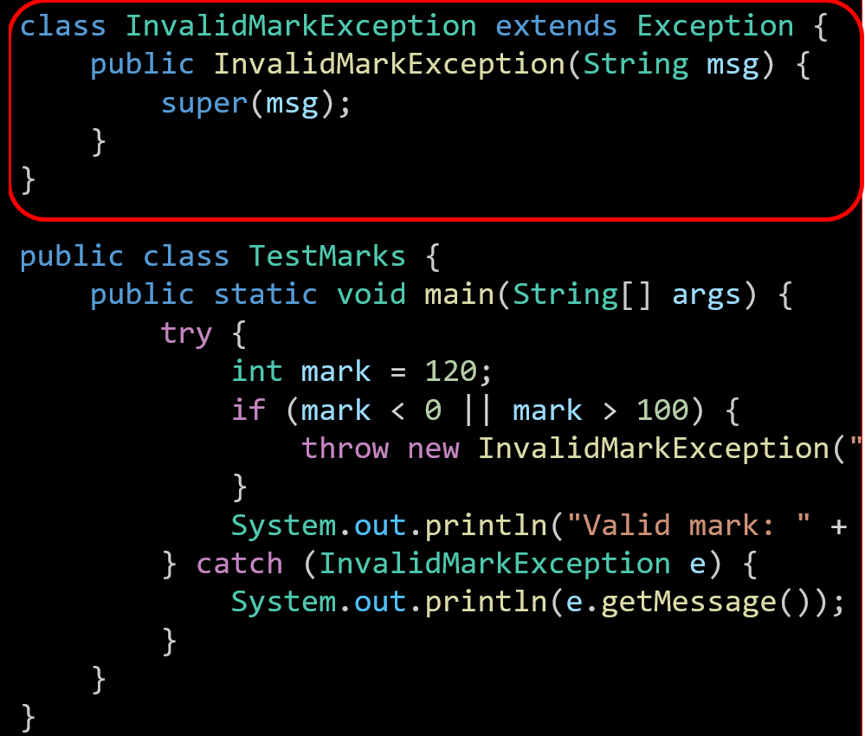
Java Solution
This creates a custom exception called InvalidMarkException.
extends Exception → means this is a special type of error (inherits from Java’s built-in Exception).
The constructor (public InvalidMarkException(String msg)) lets us send an error message to the parent Exception class using super(msg).

Slide 52
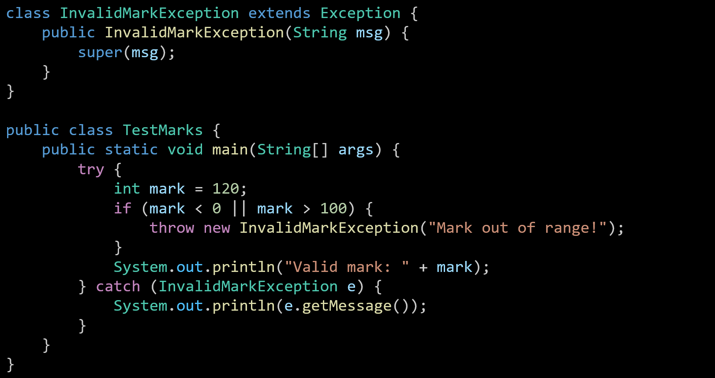
Defines a class named TestMarks. This is where we test the marks.

Slide 53
Program starts here.

Slide 54
Inside the try block, we test code that might cause an error.
Here, the mark is set to 120 (which is invalid, since marks should be between 0–100).

Slide 55
If the mark is less than 0 or more than 100 → throw our custom exception.
"Mark out of range!" is the error message that goes with it.

Slide 56
If the mark is valid, print it.
(This line won’t run here, because the mark is invalid.)

Slide 57
If an InvalidMarkException happens, we catch it and print the error message instead of crashing.

Slide 58
In short, this program shows how to make your own exception for a special rule (marks must be between 0–100). If someone tries an invalid mark, the program throws an error and prints a friendly message.

Slide 59
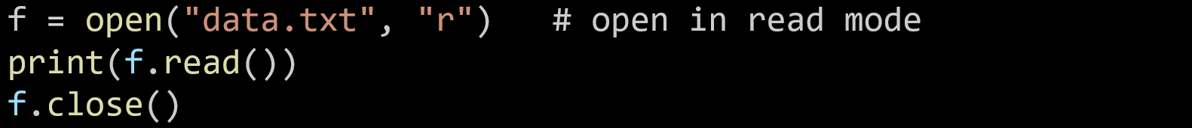
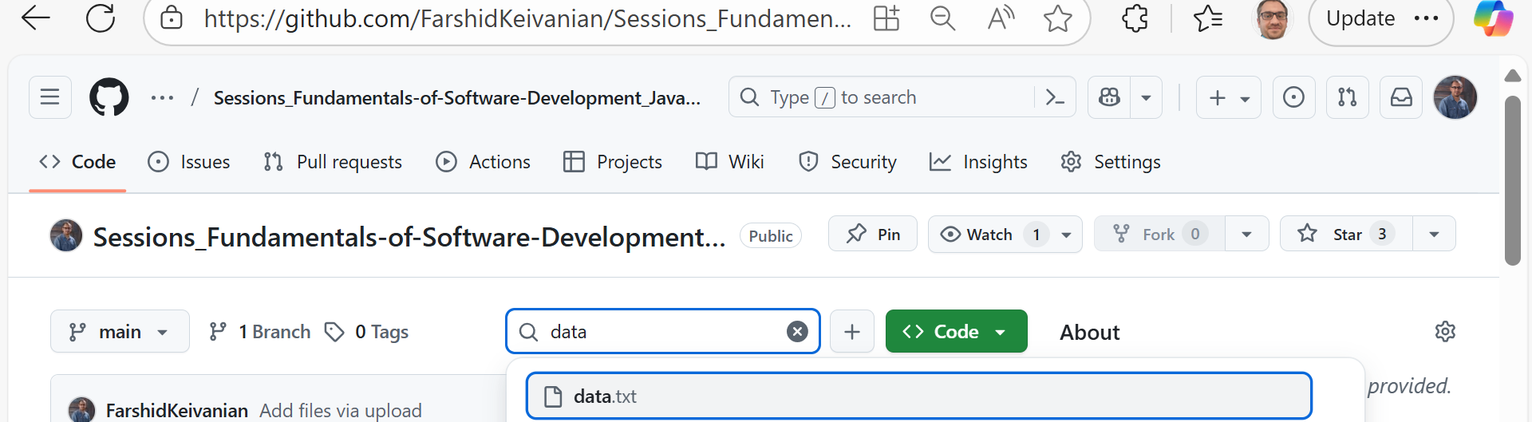
File Handling Basics (Python)
1. open(filename, mode) → open a file
Opens a file so you can read/write.
Example:
Make sure this Python file and data.txt are in the same folder, otherwise Python will not find the file.

Slide 60
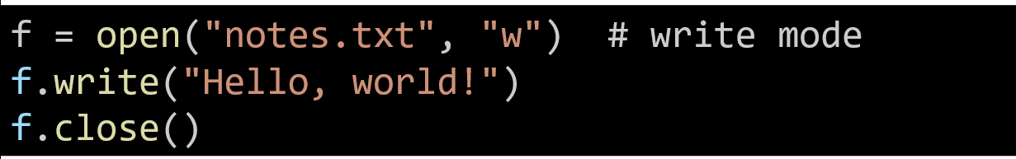
File Handling Basics (Python)
2. Modes (r, w, a, b, t)
  r → read
  w → write (overwrite file)
  a → append (add to file)
  b → binary mode
  t → text mode (default)
Example:

Slide 61
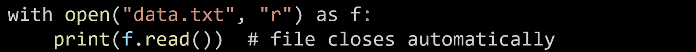
File Handling Basics (Python)
3. with open() → auto close file
File closes by itself, safer.
Example:
In this example (with open("data.txt", "r") as f:), the file closes automatically because of Python’s context manager (with statement).

Slide 62
File Handling Basics (Python)
3. with open() → auto close file
File closes by itself, safer.
Example:
How it works
  with statement creates a temporary context (a safe block).
  When you enter the block → Python opens the file and assigns it to f.
  When you leave the block (after the indented lines finish) → Python automatically calls f.close() behind the scenes, even if an error happens.

Slide 63
File Handling Basics (Python)
3. with open() → auto close file
File closes by itself, safer.
Example:
Why it’s safer
  You don’t have to remember to call f.close().
  Prevents memory leaks or locked files.
  Good habit in real projects (always use with).

Slide 64
File Handling Basics (Python)
3. with open() → auto close file
File closes by itself, safer.
Example:
Analogy (UTS Library):
It’s like using a library study room with auto-lock.
  You borrow the book (open).
  You use it (read/write).
  When you leave the room, the door auto-locks (Python auto-closes file).

Slide 65
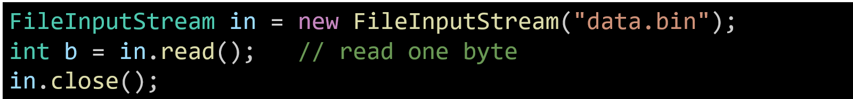
File Handling Basics (Java)
1. Streams → byte-based data flows
Think of a stream like a pipeline that carries data, one piece at a time.
Byte streams handle raw data (good for files like images, audio, videos).
Reads or writes byte by byte (not very efficient for big files, but good for low-level control). Java Example:
Analogy: It’s like drinking water through a straw – you get one sip (byte) at a time, not the whole bottle.

Slide 66
File Handling Basics (Java)
Use FileInputStream / FileOutputStream for binary files (e.g., images, audio).
For text files, it’s better to use Readers/Writers (character-based).

Slide 67
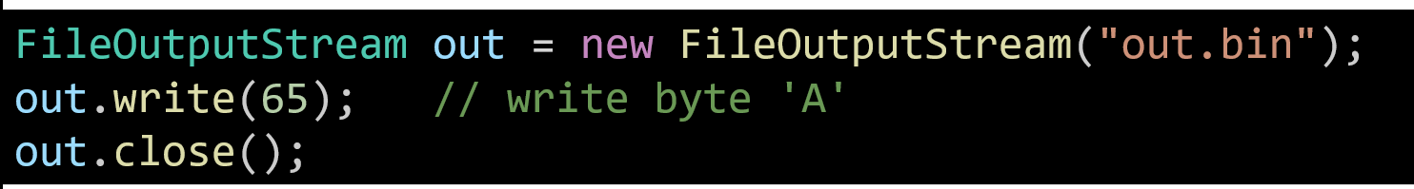
File Handling Basics (Java)
2. InputStream (read), OutputStream (write)
  InputStream → bring data in (read from file).
  OutputStream → send data out (write to file).
  Java Example:
Analogy:
Think of a water pipe system:
InputStream = water coming into your house (reading data).
OutputStream = water going out of your house (writing data).

Slide 68
File Handling Basics (Java)
2. InputStream (read), OutputStream (write)
  InputStream → bring data in (read from file).
  OutputStream → send data out (write to file).
  Java Example:
out.write(65) writes the ASCII code 65, which is the letter 'A'.
Streams only handle bytes → good for binary files, not ideal for text (use Readers/Writers for that).

Slide 69
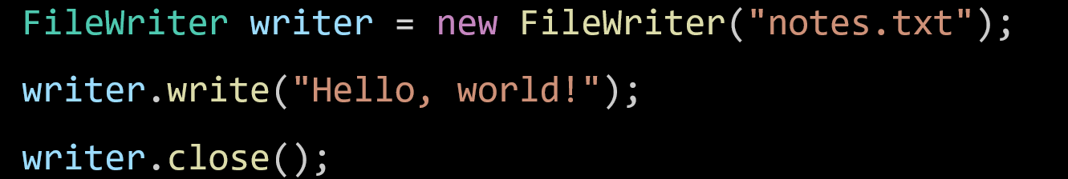
File Handling Basics (Java)
3. Readers/Writers → for text (characters)
  Use when dealing with plain text (letters, words, sentences).
  Works with characters, not raw bytes → makes it easier for text files
  Java Example:
Analogy:
Think of Streams as moving Lego blocks (bytes) one by one.
Readers/Writers are smarter – they understand letters and words, not just blocks.

Slide 70
File Handling Basics (Java)
3. Readers/Writers → for text (characters)
  Use when dealing with plain text (letters, words, sentences).
  Works with characters, not raw bytes → makes it easier for text files
  Java Example:
Use FileReader/FileWriter for text files (like .txt).
Use FileInputStream/FileOutputStream for binary files (like .jpg, .mp3).

Slide 71
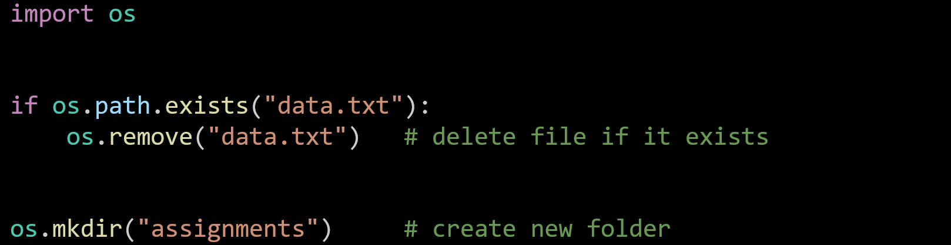
Files & Directories (Python with os module)
os.path.exists("file.txt") → check if file exists
os.remove("file.txt") → delete file
os.mkdir("new_folder") → make new folder
Python Example:
Analogy:
Think of the OS module like a school librarian:
  They can check if a book (file) is in the library.
  They can remove a book.
  They can make a new shelf (folder) for new books.

Slide 72
Files & Directories (Python with os module)
Use os.rmdir("folder") to remove an empty folder.
For deleting a folder with files inside → use shutil.rmtree("folder") (import shutil).

Slide 73
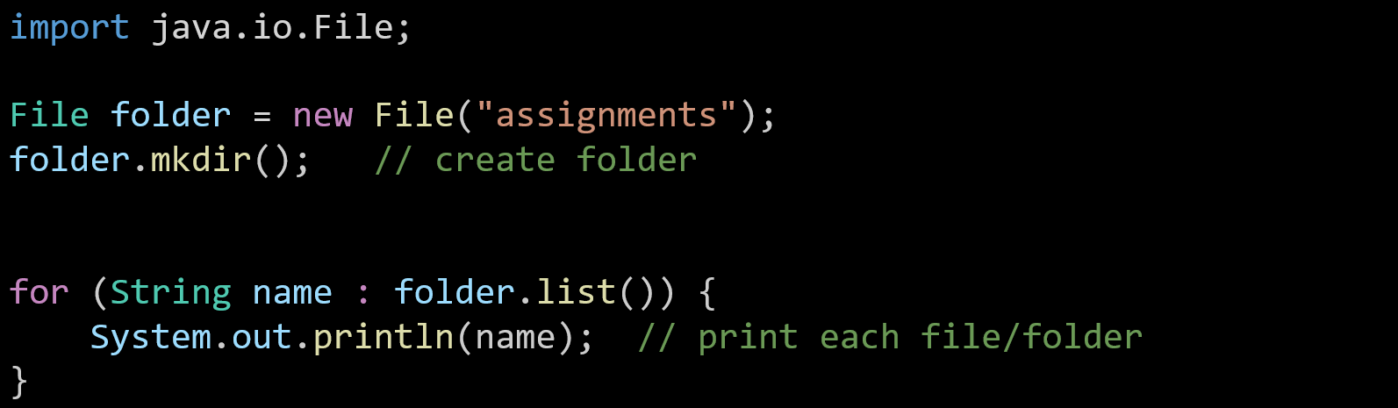
Files & Directories (Java using File class)
  mkdir() → make a new folder
  list() → list files/folders inside
  Java Example:
Analogy:
Think of the File class like a map of a building:
  mkdir() = add a new room (folder).
  list() = see what’s inside the room.

Slide 74
Files & Directories (Java using File class)
You can also check if a file/folder exists with exists().
Use delete() to remove a file or empty folder.

Slide 75
Files & Directories
Analogy (Macquarie Uni Canvas):
  Create → add a new module or folder in Canvas.
  Delete → remove an outdated file or resource.
  List → see all uploaded files and resources in a subject.

Slide 76
Unit Testing
Purpose:
Test the smallest parts of a program (functions/methods).
Make sure each piece works correctly before combining them.
Analogy (Australia):
Like NAPLAN exams → test individual student skills, not the whole school at once.

Slide 77
Unit Testing
In software development, we need to make sure that each small piece of code (like a function or method) works correctly before combining it into a bigger program. This process is called unit testing.
In Python, we can use the built-in unittest library to write and run these tests. With unittest, we can:
  Test individual functions (units of code).
  Automatically check whether the function output matches what we expect.
  Quickly find errors without manually running the code every time.
In the example below, we test a simple function add(a, b) to confirm that it returns the correct result when adding two numbers.

Slide 78
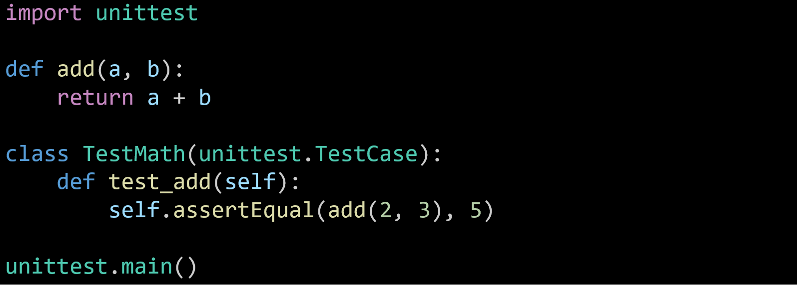
Unit Testing
Python Example (Using unittest):
This brings in Python’s unittest library, which is used to write and run tests.

Slide 79
Unit Testing
Python Example (Using unittest):
A simple function that adds two numbers. This is the function we want to test.

Slide 80
Unit Testing
Python Example (Using unittest):
Creates a test case class (a container for tests).
unittest.TestCase gives us useful testing tools like assertEqual

Slide 81
Unit Testing
Defines one test:
  Runs add(2, 3).
  Checks if the result is 5.
  If yes → test passes
  If not → test fails
Python Example (Using unittest):

Slide 82
Unit Testing
Python Example (Using unittest):
Runs the test when the file is executed.

Slide 83
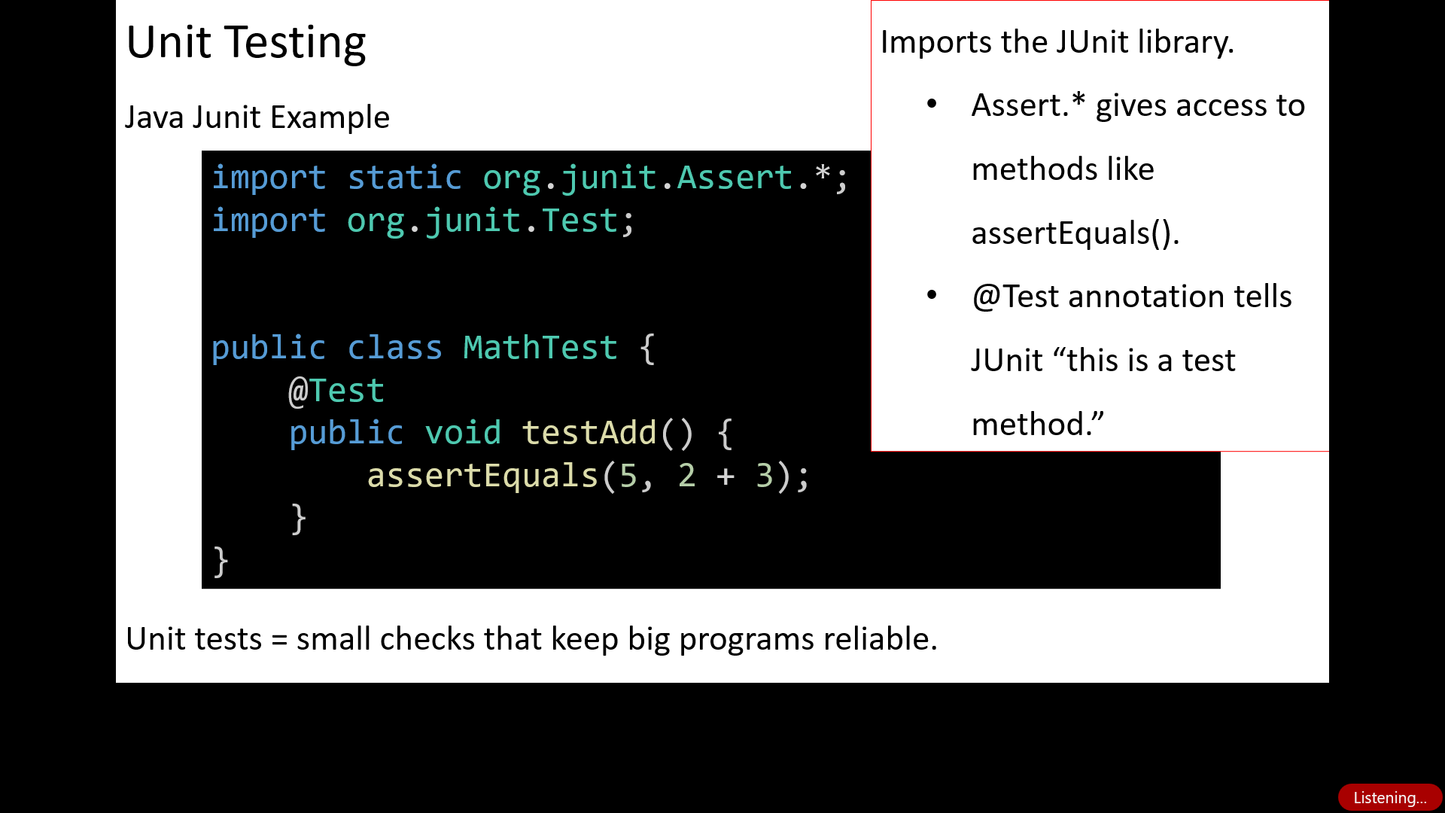

Slide 84
Defines a test class (just like in Python, all tests live inside a class).

Slide 85
Defines one test method.
  @Test → marks it as a test.
  assertEquals(expected, actual) → checks if 2 + 3 equals 5.
  If correct → pass.
  If wrong → fail.

Slide 86
Takeaway for Students
Unit tests = small checks that keep big programs reliable.
Python: unittest / pytest.
Java: JUnit.
Both use the same pattern → write a function, write a test, assert the result.

Slide 87
Analogy (Australia):
JUnit tests are like a practice quiz for each topic → you don’t wait until the final exam to find mistakes.

Slide 88
Why Exceptions? Where Do We See Testing?
Why do we need exceptions if we already check conditions with if?
Exceptions handle unexpected issues (e.g., file missing) that we can’t predict.
Where in real life do we see “unit testing”?
Quality checks in Woolworths (test one pack of strawberries to approve the batch).

Slide 89
Role-Playing Debate Questions
Q1: Should we always use exceptions instead of checking conditions?
No. Exceptions are for unexpected problems (like a file missing). Routine checks (like if a number is positive) should use simple if conditions.
Q2: Is automated testing more important than manual testing?
Automated tests are great for catching repeat mistakes quickly (like rerunning hundreds of test cases). But manual testing is still needed for things like user experience (how the app feels to use).

Slide 90
Quiz 2 Preparation & Guideline
General Rules
  8 questions, worth 2 points each → total 15 points.
  Restricted open-book: You can use lecture slides, lab notes, and printed subject materials only.
  No running code: You must read and reason through the code.
  One attempt only, 30 minutes limit.
  Quiz will be done in Week 12 lab under supervision.

Slide 91
Quiz 2 Preparation & Guideline
How to Prepare
Revise by weeks:
  Week 9 → Files, Exceptions, and Unit Testing (Python + Java)
  Week 10 → GUI basics in Python (Tkinter)
  Week 11 → GUI basics in JavaFX
Practice short examples:
  File reading/writing functions.
  How exceptions flow and how to handle errors.
  Basic GUI components and their purpose.

Slide 92
Quiz 2 Preparation & Guideline
Watch out for tricky areas:
  Immutability (things that cannot change).
  Differences in error-handling between Python and Java.
  Missing superclass or inheritance errors.
  Object vs. reference comparison.
Expect real situations:
  Some questions will be about code that works.
  Some questions will be about code that looks fine but fails for small reasons.

Slide 93
MQs designed in Week 9 (Files, Exceptions, Testing)
Q1.
Which statement about Python exception handling is incorrect?
A) try can have multiple except blocks
B) finally always runs, even if there’s a return inside try
C) Python automatically ignores runtime errors without try-except
D) else runs only if no exception occurs
Answer: C
Reason: Python does not ignore runtime errors—without try-except, they terminate the program.

Slide 94
MQs designed in Week 9 (Files, Exceptions, Testing)
Q2.
What will this code output?
try:
f = open("data.txt", "r")
print(f.readline())
except FileNotFoundError:
print("File missing")
finally:
print("Done")
A) File missing \n Done
B) Done \n File missing
C) Only File missing
D) Only Done
Answer A, Reason: FileNotFoundError triggers → prints “File missing” → finally block runs “Done”.

Slide 95
MQs designed in Week 9 (Files, Exceptions, Testing)
Q3.
Which function is correct for writing binary data in Python?
A) open("file.bin", "w")
B) open("file.bin", "wb")
C) open("file.bin", "rb")
D) open("file.bin", "a")
Answer B ,Reason: "wb" means write in binary mode. "rb" is read binary.

Slide 96
MQs designed in Week 9 (Files, Exceptions, Testing)
Q4.
Which is missing in this test?
A) Must import pytest
B) Class must extend unittest.TestCase
C) Use == instead of assertEqual
D) Test method must return True
import unittest
class MyTest:
def test_sum(self):
self.assertEqual(2+3, 5)
Answer: B, Reason: To use unittest’s assertions, class must inherit unittest.TestCase.

Slide 97
MQs designed in Week 9 (Files, Exceptions, Testing)
Q5.
Which method reads the entire file into a string?
A) f.readline()
B) f.readlines()
C) f.read()
D) f.next()
Answer: C, Reason: f.read() returns the full file as one string.

Slide 98

Happy Learning and Bright Futures Ahead!
Dr. Farshid Keivanian
Stay Connected:
linkedin.com/in/farshid-keivanian
github.com/FarshidKeivanian
Education is the most powerful weapon you can use to change the world. — Nelson Mandela

